Slide 1
CS 577 Deep Learning
Instructor: Dr. Yan Yan

Slide 2
Instructor Information
Instructor: Dr. Yan Yan
Email: yyan34@iit.edu
Assistant Professor in the Department of Computer Science at Illinois Tech
Research Areas: Computer Vision, Machine Learning, Multimedia
Published 100+ research papers in top CV, ML, AI conferences and journals
Served as area chairs in top conferences and associated editors in different journals
Class TAs: handle all homework questions, python coding questions and gradings

Slide 3

Course Information
Course Textbook
Deep Learning, by Ian Goodfellow, Yoshua Bengio and Aaron Courville, 2016
Handouts
Research Papers, Slides

Slide 4
Course Information (Cont’d)
Topics to be covered in the course:
Module 1. Neural Network
Module 2. Convolutional Neural Networks (CNNs)
Module 3. Recurrent Neural Network (RNNs)
Module 4. Deep Learning Tips
Module 5. Self-attention and Transformer
Module 6. Generative Adversarial Networks (GANs) and Diffusion Models (DMs)
Module 7. Neural Network Compression
Module 8. Transfer Learning
Prerequisite:
Knowledge of machine learning basics.
Familiar with the basic probability theory and the basic linear algebra.

Slide 5
Course Information (Cont’d)
Machine learning and deep learning is a math intensive class.
Gradings
Discussions: 10%
Assignments: 20%
Summative Module Assessments: 30%
Summative Course Assessments: 40%
(Grades: A is 90+, B is 80+, C is 70+, F is 70-)
Course Martials
Coursera

Slide 6
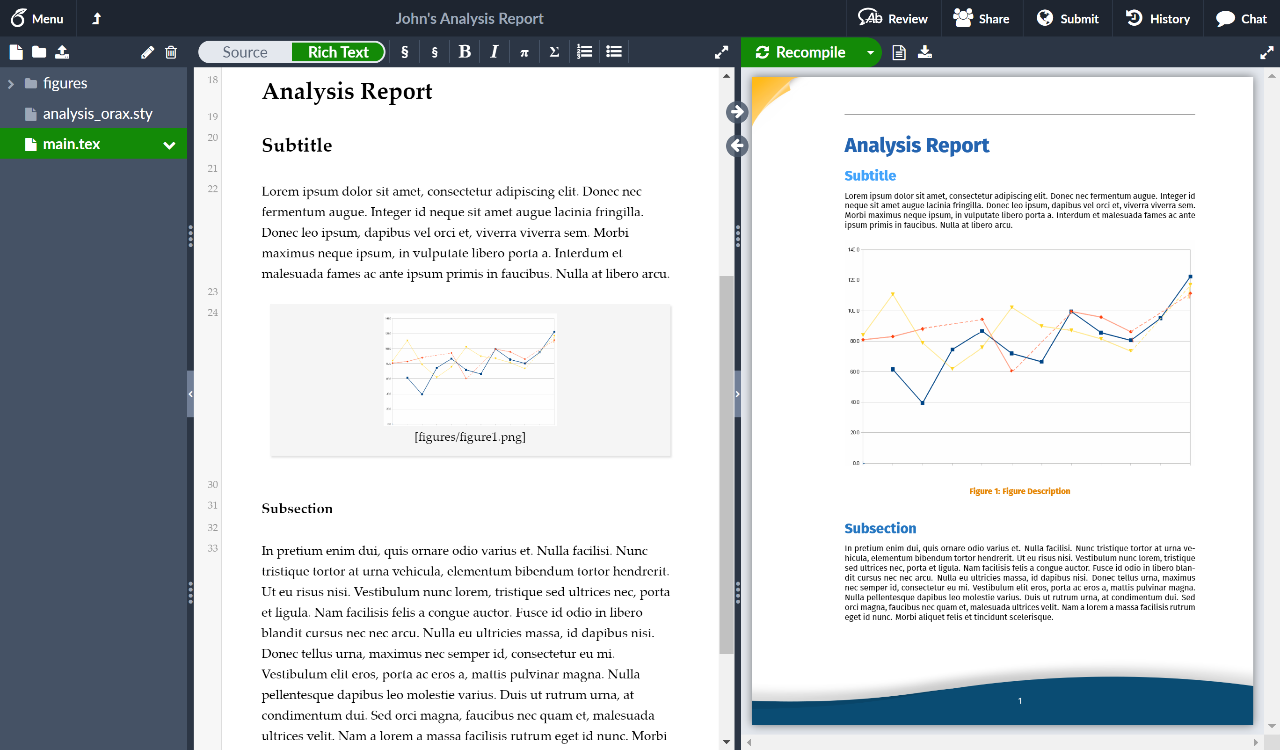
Course Information (Cont’d)
Programming language
Python
https://machinelearningmastery.com/machine-learning-in-python-step-by-step/
LaTex
You are strongly encouraged to use LaTex for the reports.
https://www.overleaf.com/
GitHub
https://guides.github.com/activities/hello-world/
A centralized place to store and track all code.
A principled way to collaborate with team members.

